Slide 1
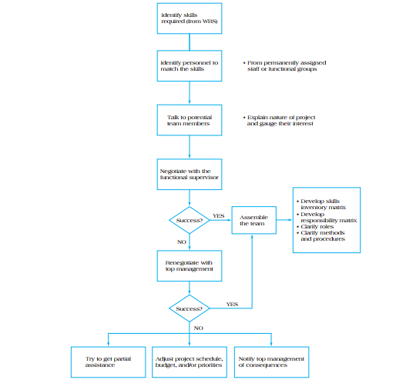

Slide 2
Effective project teams do not happen by accident. A great deal of careful work and preparation goes into the steps necessary to first staff, and then develop, project team members to the point where they begin to function jointly and the project reaps positive dividends from their collective performance.
The best-case scenario for project managers is to take over a project with a unified team composed of individuals who lobbied for and were awarded membership on the team.

Slide 3
Unfortunately, in many organizations project teams are put together based on other criteria, most notably whoever is available.
Regardless of the circumstances, the project manager is faced with the challenge of creating from a set of diverse individuals a high-performing, cohesive project team.
The preferred process, however, should be as structured as possible, and staffing is ideally aligned with the project manager’s judgment of
what is best for the project.

Slide 4
TALK TO POTENTIAL TEAM MEMBERS AND NEGOTIATE WITH FUNCTIONAL HEADS
The third step in the process of building the project team involves opening communication with likely candidates for the team and assessing their level of interest in joining the project.
In some cases, personnel have a great deal of authority in assigning their own time to projects. However, in most cases and particularly within functional organizations, all functional specialists are under the authority of departmental heads.
Consequently, at some point the project manager must begin to enter into negotiations with these functional heads for the services of prospective project team members.
These negotiations can be complex and lengthy. Departmental managers generally are not opposed to the use of their personnel on projects. They are, however, primarily concerned with the smooth operations of their organizations.
Depriving a functional manager of key personnel to serve on a project team can be seen as threatening a smoothly operating department.

Slide 5
Hence, negotiations are required. Among the issues to be decided are:
1. How long are the team members, services required? Project team members can be assigned on a full-time basis (40 hours per week) or a part-time basis (less than 40 hours per week). Furthermore, the team member may be assigned for a fixed period (e.g., six months) or for the duration of the project.
2. Who should choose the person to be assigned to the project? Another point of negotiation is the question of who should select the individual to serve on the project team. The functional manager may have his / her own ideas as to the best choice, while the project manager may employ different criteria and come up with other possible candidates.

Slide 6
3. What happens when special circumstances arise?
In the event of some emergency or special circumstance, the functional department head may wish to retain control of the team member or have the option of suddenly recalling that individual back to work on departmental activities.
How will “emergencies” be defined? If the team member is recalled, how will the department provide a replacement? What is the maximum amount of time a team member can be removed from his project duties? All these questions are important and should be resolved prior to the appointment of project team members.
Most project resources are negotiated with department managers. This point is critical: for the majority of project managers, their outright control over project team members may be limited, particularly early in the process when project team assignments are being made.

Slide 7
The best strategy a project manager can engage in at this point is to think carefully about the types of expertise and skills that will be required for successful completion of the project, and begin bargaining with these clear goals in mind.
Treat functional managers as allies, not opponents.
The organization supports the project and therefore functional departments will support it as well, but their level of support must be carefully planned in advance.

Slide 8
Majority of project managers, their outright control over project team members may be limited, particularly early in the process when project team assignments are being made.
The best strategy a project manager can engage in at this point is to think carefully about the types of expertise and skills that will be required for successful completion of the project, and begin bargaining with these clear goals in mind.
Treat functional managers as allies, not opponents.
The organization supports the project and therefore functional departments will support it as well, but their level of support must be carefully planned in advance.

Slide 9
BUILD IN FALLBACK POSITIONS
what are your options as the project manager when resources are not available? Suppose, for example, that you need three highly trained design engineers for the project and the head of engineering is unwilling to part with them or negotiate a compromise. As figure 6.2 demonstrates, in the event that negotiations with functional managers and top managers are not fruitful, the project manager is faced with three basic alternatives.
Try to negotiate for partial assistance the best alternative to an outright refusal is to seek some limited assistance. One reason for this approach is that it gets your foot in the door.
Once the personnel are assigned to the project, even on limited terms, it forms the basis for your returning to the department head at a later point to ask for them again, while only slowing down the project marginally. This principle argues, in effect, that it is better to have half a loaf than none.

Slide 10
Adjust project schedules and priorities accordingly when critical resources are not available, the project schedule must be adjusted to reflect this fact., There is no point in developing a sophisticated project schedule if it is not supported by resources. To put it another way, until we can match people to project tasks, we cannot make progress.
With a failure to convince functional managers that their resources are needed to support the project, serious and honest adjustments must be made to all project plans, including scope documents, schedules, risk assessment, and so forth.

Slide 11
NOTIFY TOP MANAGEMENT OF THE CONSEQUENCES Failing to gain necessary resources must be reported to top management, the ultimate sponsors of the project. They may, in the end, become the final arbiters of the resource and staffing question. In the face of persistent resistance from a functional manager, the only recourse may be to present to top management, as candidly as possible, the implications for project success without sufficient support. The final decision then comes down to top management: they will either support the project and require that staffing be completed as requested, suggest a compromise, or support the functional manager. In the first two cases, the project will proceed; in the third, top management is effectively ending the project before it has begun.
ASSEMBLE THE TEAM
When the project has been staffed and approved, the final step is assembling the project team. This involves developing a skills inventory matrix that identifies the skills needed for the project against the skills team members have acquired, and a responsibility matrix using the Responsibility Activity Matrix (RAM) methodology.
Also, all project team roles and responsibilities must be clarified, along with all project team methods, expectations, and standard operating procedures. Where any of these do not exist, it will be necessary to begin establishing them.

Slide 12
Characteristics of effective project team
A CLEAR SENSE OF MISSION
PRODUCTIVE INTERDEPENDENCY AMONG THE TEAM MEMBERS
COHESIVENESS
TRUST
ENTHUSIASM
RESULT ORIENTATION

Slide 13
REASONS WHY TEAM FAILS
POORLY DEVELOPED OR UNCLEAR GOALS
UNCLEAR GOALS INTERPRET MULTIPLE INTERPRETATIONS
UNCLEAR GOALS IMPEDE THE WILLINGNESS OF TEAM MEMBERS TO WORK TOGETHER
UNCLEAR GOALS INCREASE CONFLICT
POORLY DEFINED TEAM ROLES AND INTER DEPENDENCIES
LACK OF PROJECT TEAM MOTIVATION
THE PROJECT IS PERCEIVED AS UNNECESSARY
THE PROJECT MAY HAVE LOW PRIORITY
POOR COMMUNICATION
POOR LEADERSHIP
TURNOVER AMONG PROJECT TEAM MEMBERS
DYSFUNCTIONAL BEHAVIOUR

Slide 14
